Slide 1

Autonomous Car Review
James Bruska
Matthew Strenk, Robin Kuhns, Ryan Shippee,
Milton Griffin, Timothy Law

Slide 2
Hardware List
FRDM K64F or Zybo Zynq-7000 Development Board
Pixy CMUcam5 Image Sensor
TAOS TSL1401-DB Linescan Camera
Cytron MDD10A Dual Drive Motor Driver
HiTEC HS-422 Deluxe High Speed Servo
AZ1084T 5V Linear Regulator
BA33DD0T 3.3V Linear Regulator
FG24X5R1E226MRT06 22μF Capacitors

Slide 3
Capability | FRDM | Zybo
Line Following | Yes | Yes
Variable Speed | Yes | Yes
Mode Selection | Yes | Yes
Intersection Detection | Yes | Yes
Signal Detection | Yes | IN PROGRESS
Turn at Intersection | Yes | Yes
Stop Line Detection | Yes | Yes
Line Recovery | Yes | Yes
Data Logging | IN PROGRESS | No

Slide 4
Basic Mode Testing
Test | FRDM | Zybo
System Startup | Yes | Yes
Mode Accessible | Yes | Yes
Follows Track | Yes | Yes
Turning | Yes | default left only
Power Off | Yes | Yes

Slide 5
Speed Mode Testing
Test | FRDM | Zybo
System Startup | Yes | Yes
Mode Accessible | Yes | Yes
Follows Track | Yes | Yes
Turning | Yes | default left only
Track Completion | Yes | Yes
Power Off | Yes | Yes

Slide 6
Collision Mode Testing
Test | FRDM | Zybo
System Startup | Yes | Yes
Mode Accessible | Yes | Yes
Follows Track | Yes | Yes
Turning | Yes | default left only
Catch Leader | Yes | No
Track Completion | Yes | Yes
Power Off | Yes | Yes

Slide 7
Discovery Mode Testing
Test | FRDM | Zybo
System Startup | Yes | Yes
Mode Accessible | Yes | Yes
Locates Track | Yes | Yes
Follows Track | Yes | Yes
Turning | Yes | default left only
Track Completion | Yes | Yes
Power Off | Yes | Yes

Slide 8
Optional Features
Capability | FRDM | Zybo
Headlights | Yes | Yes
Bluetooth | No | No
GUI (Monitor)) | Not Integrated | Not Integrated
GUI (Manual Mode) | Not Integrated | Not Integrated

Slide 9
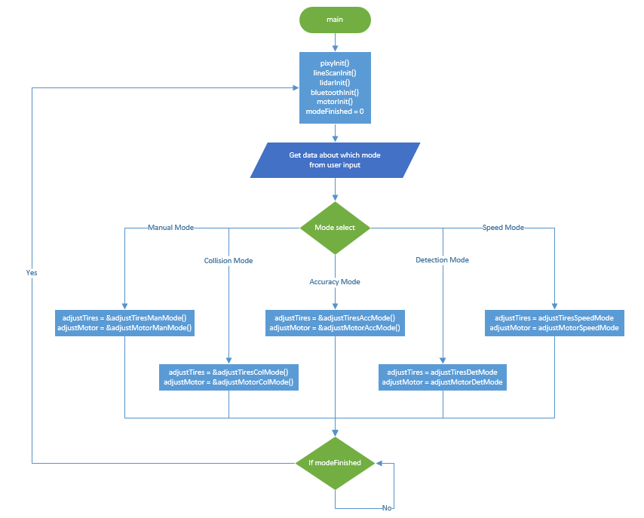
Unique Design Characteristics [Function Pointers]

Slide 10
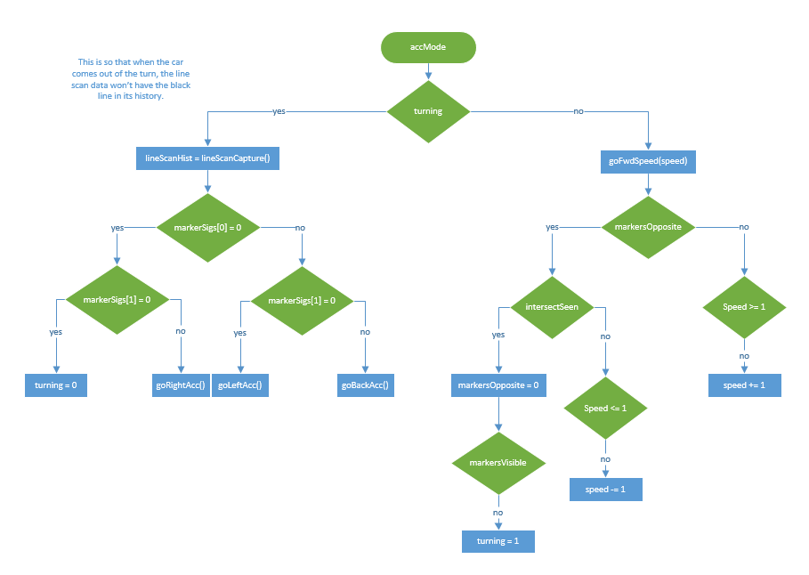
Unique Design Characteristics [No Main Needed]

Slide 11
Unique Design Characteristics [Line Detection]

Slide 12
Unique Design Characteristics [Software]

Slide 13
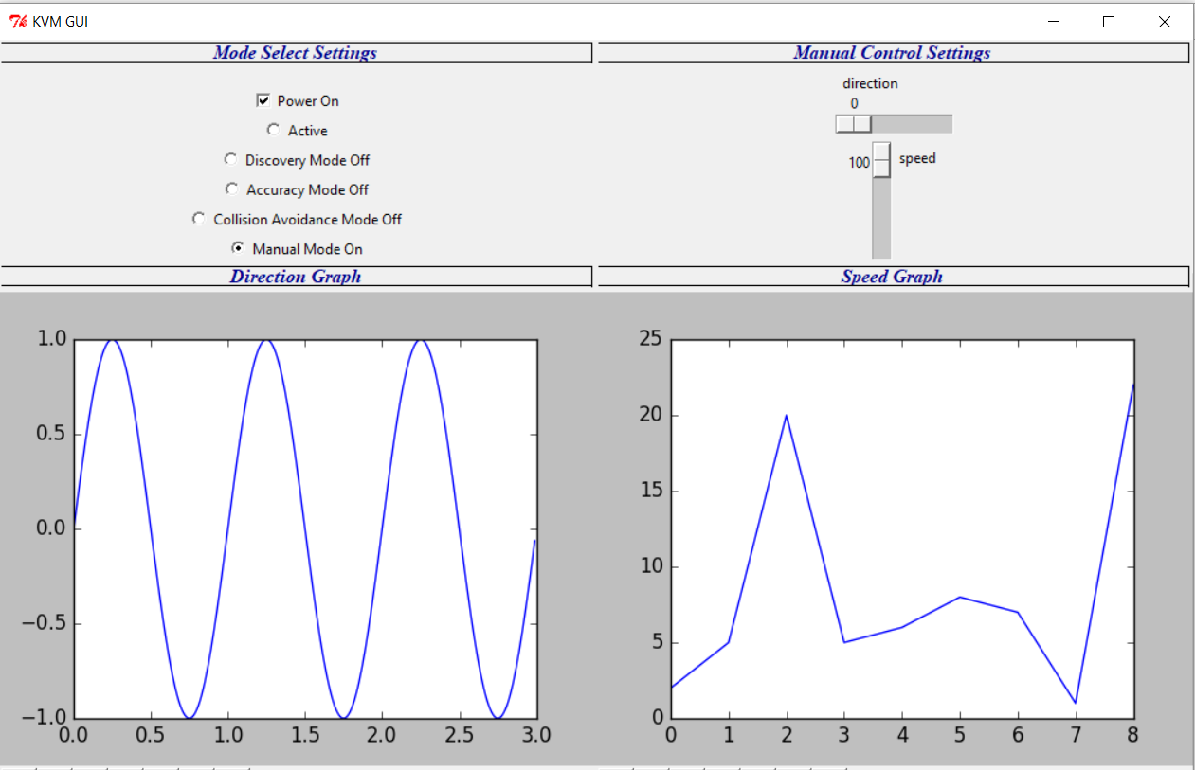
Unique Design Characteristics [Software]

Slide 14
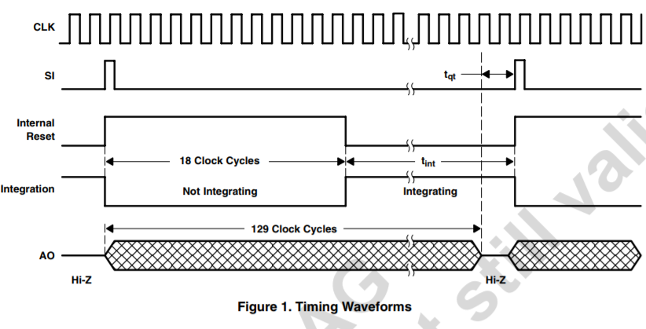
Unique Design Characteristics [Software]

Slide 15
Unique Design Characteristics [Hardware]
Noise Attenuation
High Efficiency Voltage Distribution Module
Careful Consideration for Mechanical Construction
Professional Quality Custom Backplates
Other Custom Parts (Breadboard, Steering Armature)

Slide 16
Design Weaknesses and Flaws
CMU Pixy Camera on the Zybo board
Lidar on both cars
Bluetooth on both cars
SD Card

Slide 17
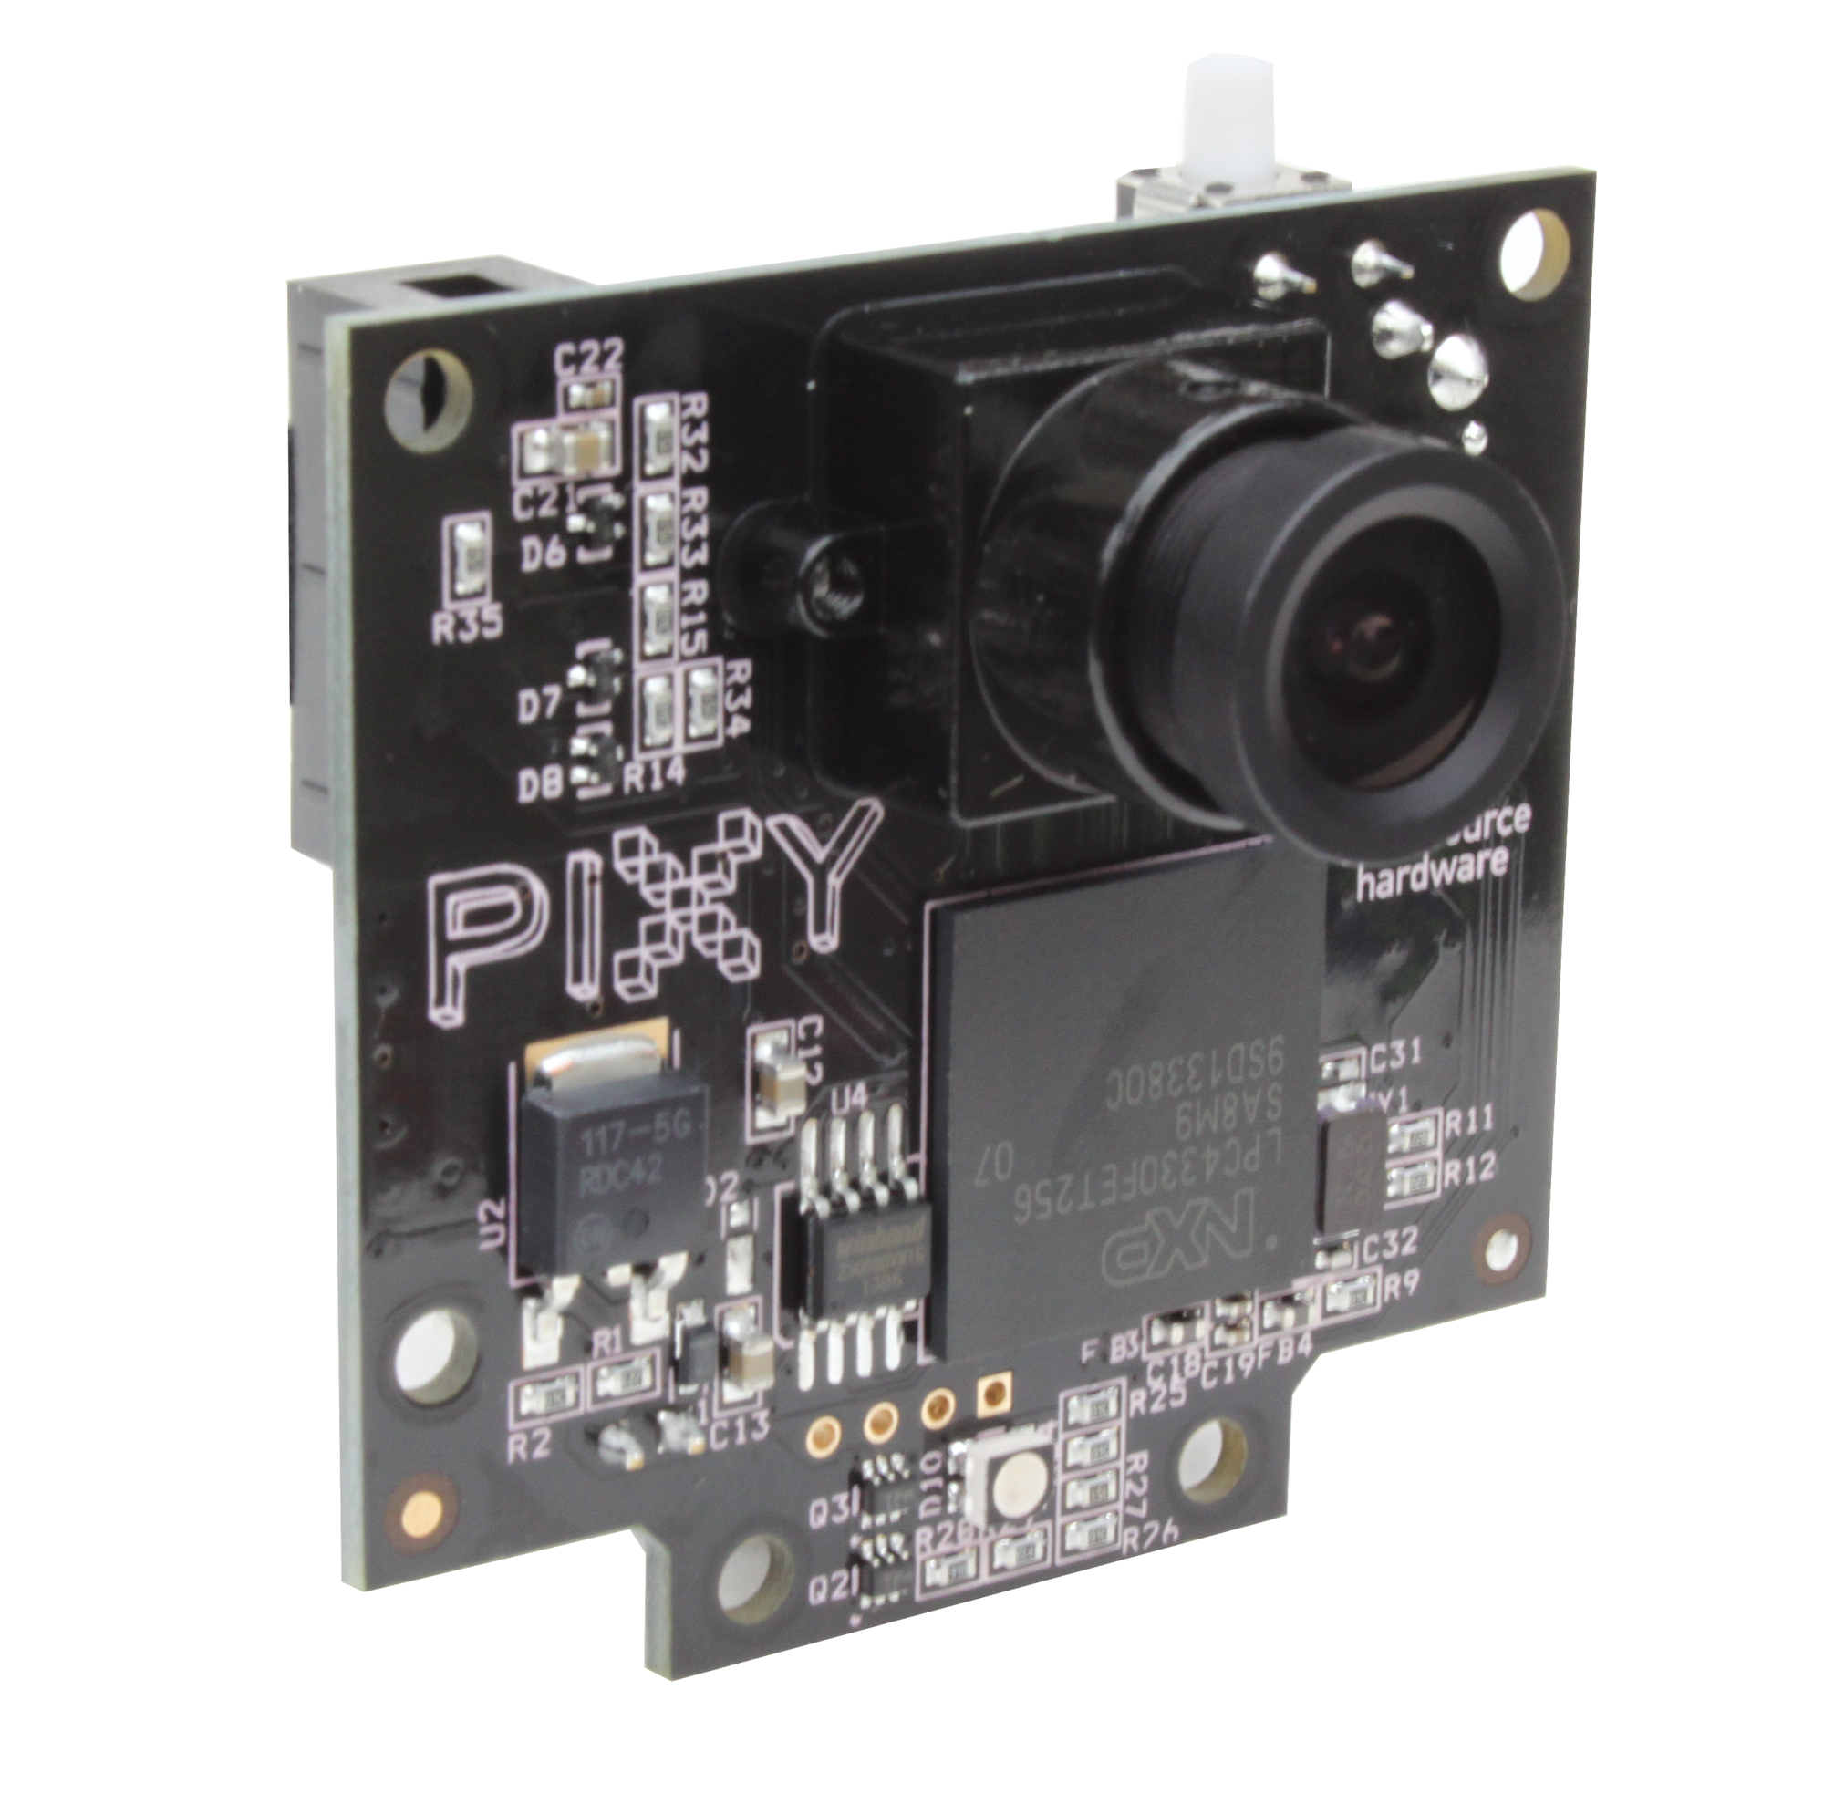
Zybo’s Pixy Camera
Could not get the Pixy Camera to communicate with the Zybo Board
All of the logic is in place
Because of this there is no collision avoidance mode on Zybo and it will not turn at the intersection

Slide 18
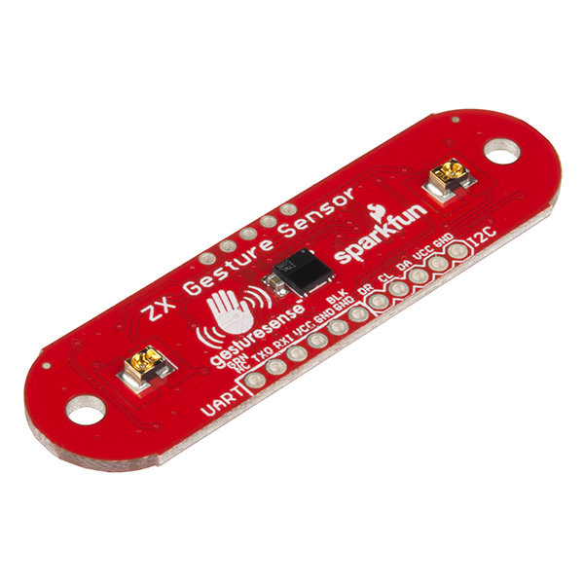
Lidar: Weakness
Ended up not being used
Was not reliable enough to continuously give the correct distance
Using the Pixy Camera was more reliable

Slide 19
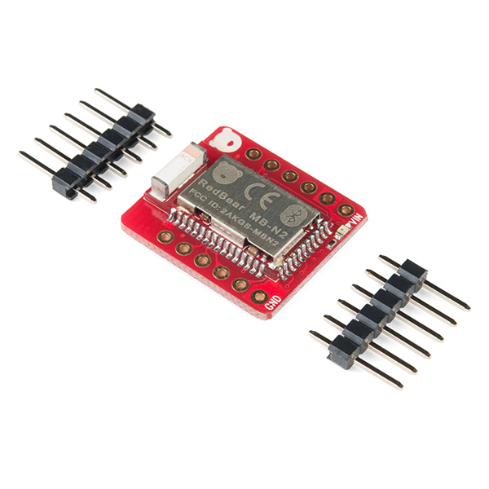
Bluetooth: Weakness
Should have chosen a more simplistic approach
Firmware needs to be loaded onto it
Data Logging and GUI would work if a Bluetooth connection existed

Slide 20

SD Card: Weakness
Planned to replace data logging on GUI on Bluetooth
File could not be created
Worked on its own

Slide 21
Technology Assessment
Benefits:
Formal understanding of mechanical characteristics of performance vehicles
Adverse Effects:
Misconceptions that could have been developed through a flawed design implementation

Slide 22
Technology Serving Humanity
Adaptations:
Manufacturing facilities could use this technology in assembly areas, with proper safety guidelines
Cranes / bulldozers with autonomous capabilities, controlled from a tower
Autonomous vehicles using PID equations to properly (and safely) follow the roads

Slide 23
Unique Innovation: Ziegler-Nichols Tuned PID Eq.
1st Formula:
DC = 7.5 - (lineError * 0.042)
2nd Formula:
DC = dutyCyclePrev - (lineError * pidA) - (lineErrorPrev)* pidB) - (lineErrorPrev2 * pidC)
3rd Formula:
DC = 7.5 - (lineError * pidA) - ((lineError - lineErrorPrev) * pidC)

